Slide 1


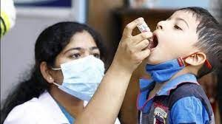
TEEKA DOST
CHILDREN IMMUNISATION WESITE TO FIGHT AGAINST POLIO,HEPATITIS A
ETC.
TEAM #TEEKA KARTIK SHARMA DHRUV KHANDELWAL ASEEM GUPTA

Slide 2

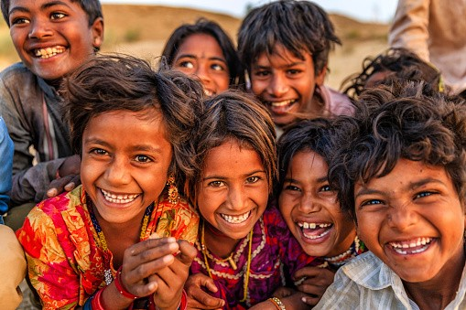

KEY FEATURES
VACCINE SLOT BOOKING VACCINE REMINDER CHATBOT
SUBSCRUBTION OF NEWSLETTER- (CROWNJOBS)
DOCTORS APPOINTMENT
CHECKING AVILABILTY OF VACCINE AND SENDING REMINDER THROUGH WATSAPP
LINKING DATABASE THROUGH ADHAR

Slide 3

FRAMEWORK USED
NODEJS EXPRESSJS EJS
HTML CSS
JAVASCRIPT
PYTHON(PYWHATKIT.CHATTERBOT,D ATETIME)
CROWNJOBS
DBMS ETC...

Slide 4
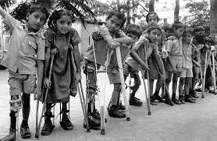
THANK YOU!!!!
TEAM #TEEKA KARTIK SHARMA DHRUV KHANDELWAL ASEEM GUPTA
BTECH25042.21@BITMESRA.AC.IN 9412229666

